Slide 1

Temporal Analysis Performant Evolution
to positively empower enterprise with the INSIGHTS needed to win
https://github.com/shawnmccarthy/TEMPORAL
https://github.com/shawnmccarthy/TEMPORAL/projects/1

Slide 2

A) Research: TCN
Time series analysis is widely used in fields such as business, economics, finance, science, and engineering.
Our approach seeks to identify shifting economic phase and provide a framework for making asset allocation decisions according to the probability that asset may outperform or underperform.
Temporal Convolutional Networks have recently been applied to time series data where longer term memory of seasonality of the dataset are required
Research Encoder/Decoder and Knowledge Driven Event Embedding

Slide 3

Schedule
Week | Topic | Output
1 | Temporal Convolutional Network Analysis https://github.com/unit8co/darts | Schedule
2/3 | Standard TCN - Dilated Convolutional Layers https://towardsdatascience.com/temporal-coils-intro-to-temporal-convolutional-networks-for-time-series-forecasting-in-python-5907c04febc6 https://github.com/philipperemy/keras-tcn https://www.frbsf.org/economic-research/indicators-data/daily-news-sentiment-index/ | Stock Macro and Sector data
4/5 | Deep TCN http://www.gm.fh-koeln.de/ciopwebpub/Thill20a.d/bioma2020-tcn.pdf | Stock Macro and Sector data
6/7 | N-BEAT - Neural Basis Expansion Analysis Time Series Forecasting https://unit8co.github.io/darts/examples/07-NBEATS-examples.html | Stock Macro and Sector data
8/9 | Temporal Fusion Transformer https://ai.googleblog.com/2021/12/interpretable-deep-learning-for-time.html https://towardsdatascience.com/temporal-fusion-transformer-a-primer-on-deep-forecasting-in-python-4eb37f3f3594 https://unit8co.github.io/darts/examples/13-TFT-examples.html | Stock Macro and Sector data
10 | Spring Break
11/12/13 | Goal: Best Network for Temporal prediction of time series data (e.g. market data) | Summary of results

Slide 4
Schedule
Week | Topic | Output
14/15 | Knowledge-Driven Based event embedding Paulheim (2016) http://www.semantic-web-journal.net/system/files/swj1167.pdf | Design of embedding
16 | Prepare for phase 2

Slide 5
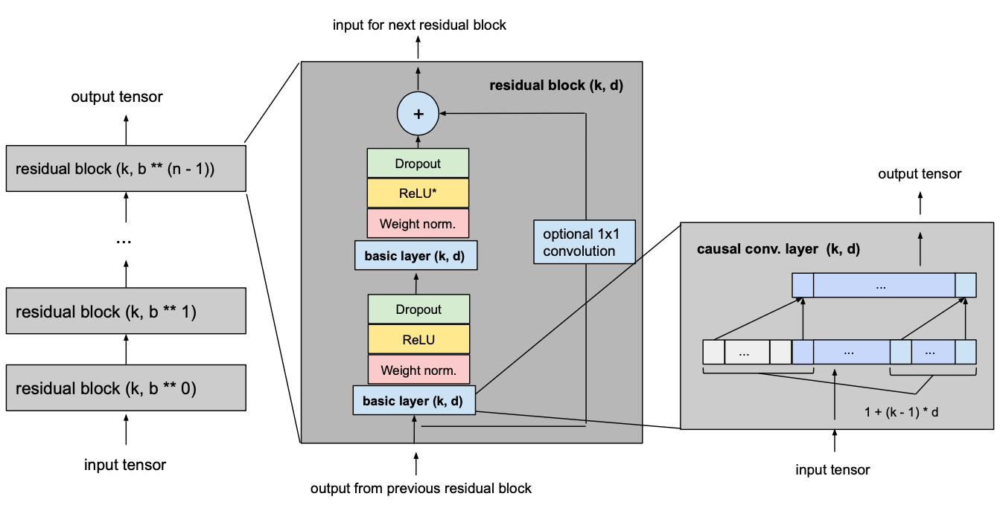
TCN Basic model
Given input_length, kernel_size, dilation_base and the minimum number of layers required for full history coverage, TCN network would look something like this
Consists of dilated, causal 1D convolutional layers with the same input and output lengths

Slide 6
Hyper Parameters
Weekly forecast
model = TCNModel( input_chunk_length=365, output_chunk_length=7, n_epochs=50, dropout=0.2, dilation_base=2, weight_norm=True, kernel_size=5, num_filters=8, nr_epochs_val_period=1, random_state=0, )
Periods to wait for Loss
Random weights
Notes:
To normalize the input of hidden layers (which counteracts the exploding gradient problem among other things), weight normalization is applied to every convolutional layer.
In order to prevent overfitting, regularization is introduced via dropout after every convolutional layer in every residual block. The following figure shows the final residual block.

Slide 7
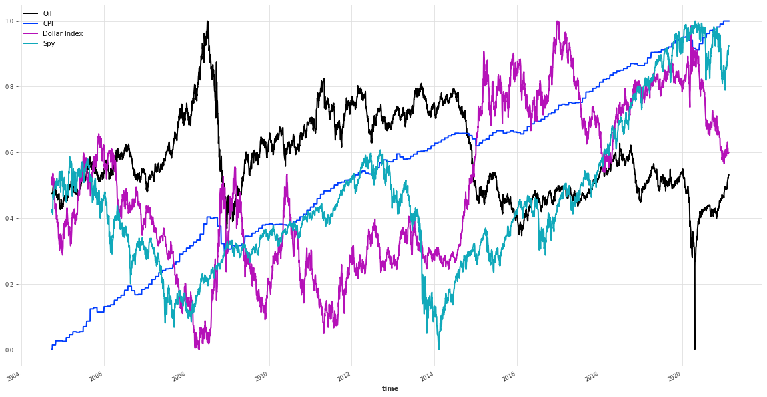
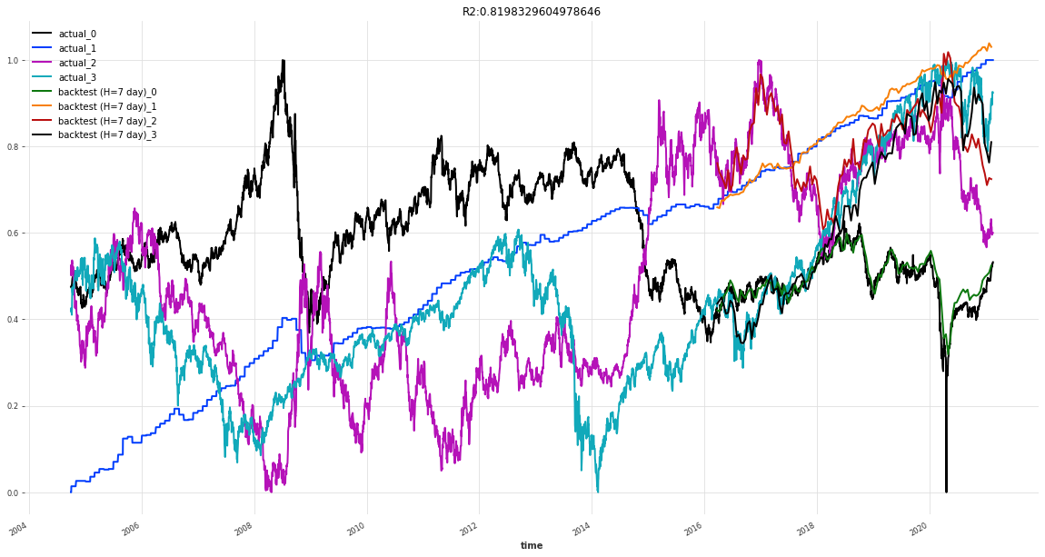
Oil, CPI, Dollar Index
Backtest RMSE = 0.03857457909272441
Notes:
R2 (coefficient of determination) regression score function.
It takes a time series, a starting point (here, we are starting at half of the series) and a forecast horizon. It returns the TimeSeries containing the historical forecasts would have been obtained when using the model to forecast the series with the specified forecast horizon (here 3 months), starting at the specified timestamp (using an expanding window strategy).

Slide 8

What’s Happened
Compare different hyper parameter sets to get a better understanding of kernel and dilation towards network and loss
Review covariate approach to pull in one additional knowledge

Slide 9
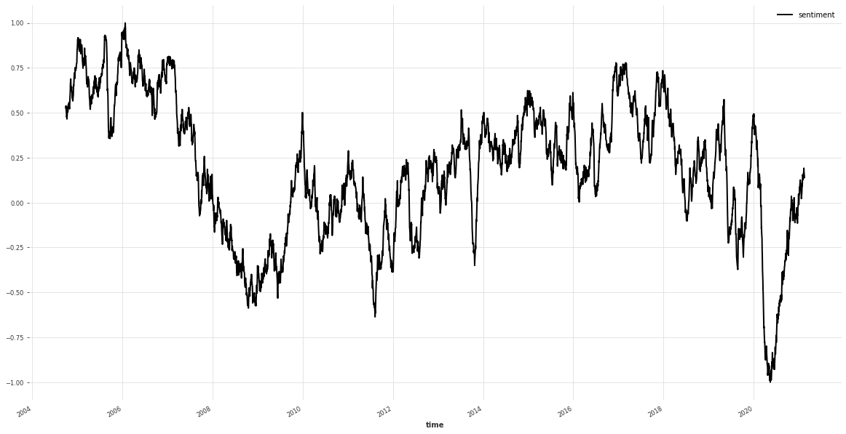




News sentiment
References
Buckman, Shelby R., Adam Hale Shapiro, Moritz Sudhof, and Daniel J. Wilson. 2020. “News Sentiment in the Time of COVID-19.” FRBSF Economic Letter 2020-08 (April 6).
Shapiro, Adam Hale, Moritz Sudhof, and Daniel J. Wilson. 2020. “Measuring News Sentiment.” FRB San Francisco Working Paper 2017-01.
The Data tab contains a news sentiment measure from January 1, 1980, to the latest day available.
$$s_{a}^{i}=f_{t(a)}^{i}+f_{p\left(a\right), j\left(a\right)}^{i}+ε_{a}^{i}$$
$$s_{a}^{i}$$
is the positivity score for article
is a sample-day (t) fixed effect
is a newspaper*type fixed effect
$$f_{t(a)}^{i}$$
$$f_{p\left(a\right), j(a)}^{i}$$

Slide 10
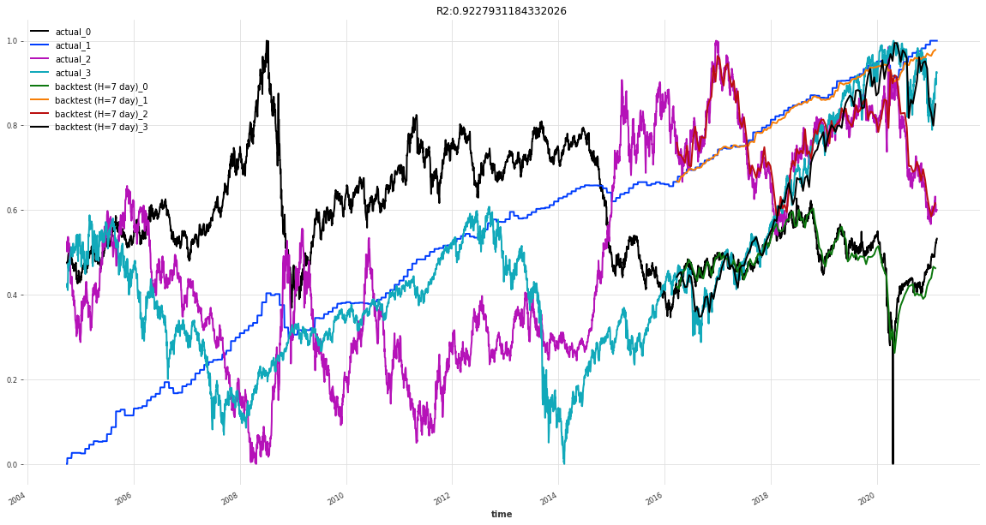
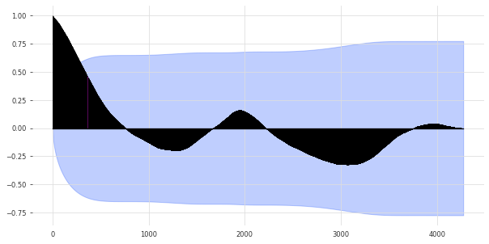
With covariate News
Backtest RMSE = 0.024682999973297988
seasonality = check_seasonality( ["Spy"], max_lag=len(series))
(True, 1943) = 5.3 years (*2018 - growing economy on average 3.2 years, recession 1.5 years)
Notes:
Plot the autocorrelation function
Plots lags on the horizontal and the correlations on vertical axis.

Slide 11
Different models
tcn_model(5, 2, train, val)
tcn_model(5, 2, train, val, train_cov, val_cov)

Slide 12
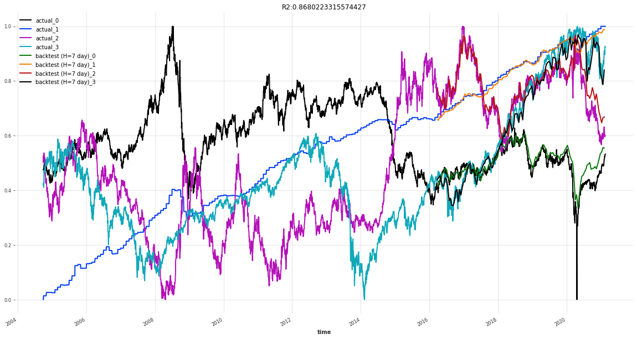

Different models
tcn_model(3, 2, train, val)
tcn_model(3, 2, train, val, train_cov, val_cov)

Slide 13
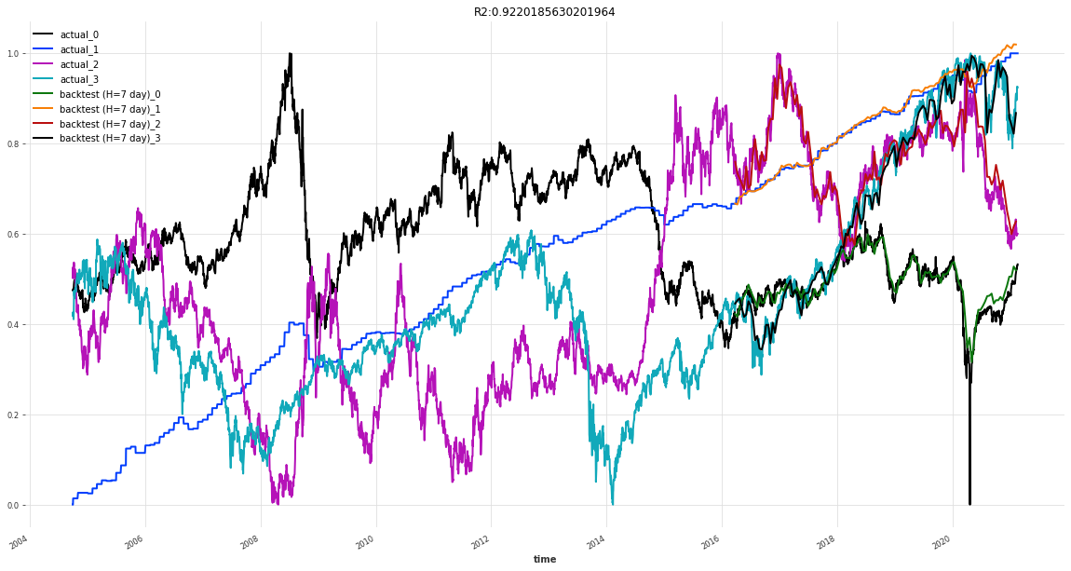
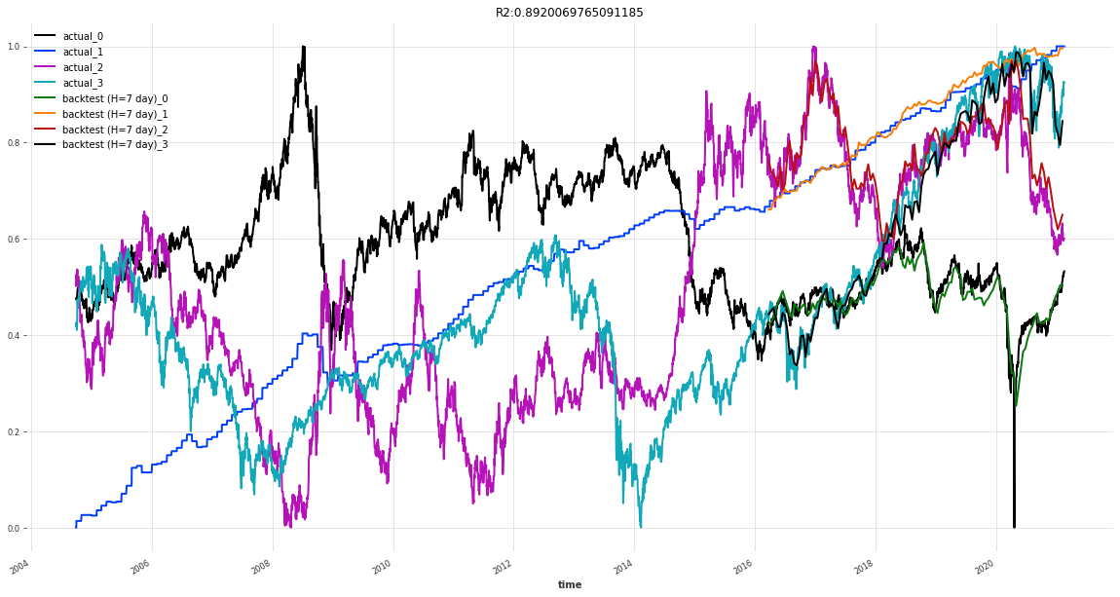
Different models
tcn_model(7, 2, train, val)
tcn_model(7, 2, train, val, train_cov, val_cov)

Slide 14
TCN Model
DeepTCN Models
Probabilistic forecasting using TCN model with Likelihood - GaussianLikelihood()

Slide 15
Guassian likelhoold
https://arxiv.org/pdf/1906.04397.pdf
Probabilistic Forecasting with Temporal Convolutional Neural Network
Yitian Chena , Yanfei Kangb,∗ , Yixiong Chenc , Zizhuo Wangd
Probabilistic forecasting framework based on convolutional neural network
Probabilistic forecasts of future observations can be achieved by directly predicting the parameters of the hypothetical distribution (e.g., the mean and the standard deviation for Gaussian distribution) based on maximum likelihood estimation

Slide 16
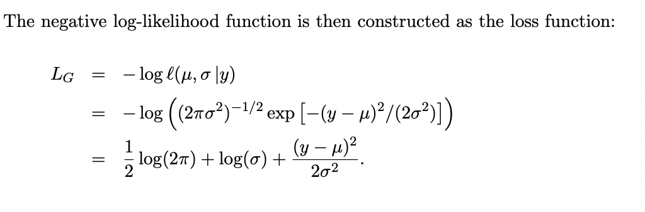
Parameter approach
Authors take Gaussian distribution as an example, for each target value y, the network outputs the parameters of the distribution, namely the mean and the standard deviation, denoted by µ and σ, respectively

Slide 17
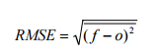
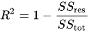
Comparison
 | 5/2 | 5/2 news | 3/2 | 3/2 news | 7/2 | 7/2 news
 | rsme --- R2 | rsme --- R2 | rsme --- R2 | rsme --- R2 | rsme --- R2 | rsme --- R2
TCN | 0.0385 --- 0.8198 | 0.0246 ---- 0.9227 | 0.0291 ---- 0.8680 | 0.0302 ---- 0.8694 | 0.0242 ---- 0.9220 | 0.0292 ---- 0.8920
TCN - Gaussian | 0.0248 --- 0.9187 | 0.0249 ---- 0.9119 | 0.0241 ---- 0.9183 | 0.0239 ---- 0.9273 | 0.0329 ---- 0.8737 | 0.0225 ---- 0.9289
Notes:
In statistics, the coefficient of determination, denoted R² or r² and pronounced "R squared", is the proportion of the variation in the dependent variable that is predictable from the independent variable(s).
1 would be perfect
Root Mean Squared Error (RMSE).
sum of squares of residuals / total sum of variances
Simply put between the observed outcomes and the observed predictor values
Here is my question MASE (Mean Absolute) or SMAPE symmetric Mean Absolute Percentage Error

Slide 18
What's next
DeepTCN Models
Probabilistic forecasting using TCN model with Likelihood - GaussianLikelihood()

Slide 19
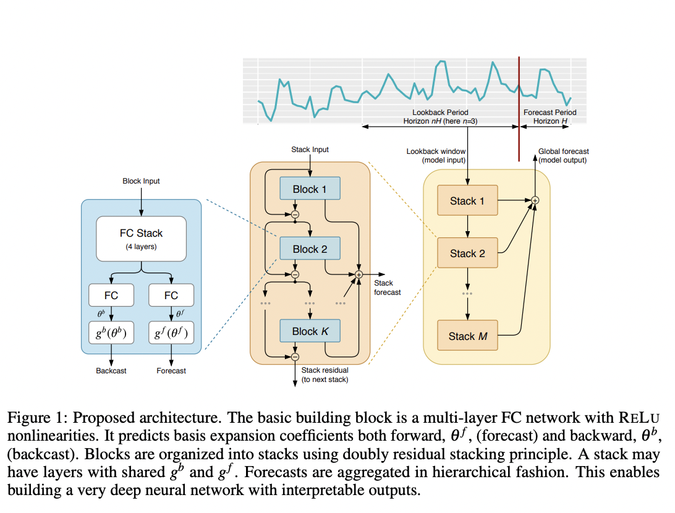
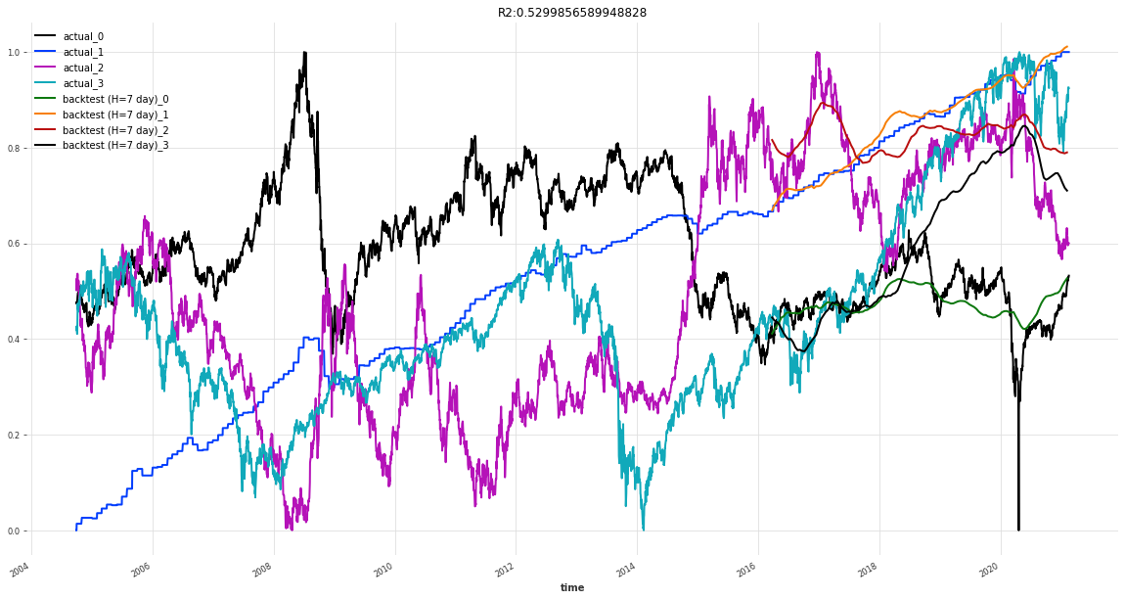
N-beats NEURAL BASIS EXPANSION ANALYSIS FOR INTERPRETABLE TIME SERIES FORECASTING
https://arxiv.org/pdf/1905.10437.pdf

Slide 20
What's next
N-Beats
Generic - useses as little prior knowledge as possible, with no feature engineering, no scaling and no internal architectural components
interpretable architecture consisting of two stacks: A trend stack and a seasonality stack. The architecture is designed so that:
The trend component is removed from the input before it is fed into the seasonality stack
The partial forecasts of trend and seasonality are available as separate interpretable outputs

Slide 21
Comparison
 | 1/4/10 Block/ layer/ stack | 1/4/10 news | 3/4/10 | 3/4/10 news | 7/4/10 | 7/2 news
 | rsme --- R2 | rsme --- R2 | rsme --- R2 | rsme --- R2 | rsme --- R2 | rsme --- R2
N-BEATS | 0.2618 --- -8.9508 | 0.1718 ---- -6.8629 | 0.2372 ---- -4.7372 | 0.2022 ---- -4.2964 | 0.1859 ---- -1.5329 | 0.1637 ---- -2.595
N-BEATS Classic | 0.1044 -- -0.2296 | 0.1270 -- -0.3730 | 0.0796 -- 0.0281 | 0.1272 -- -0.9829 | 0.1201 -- -0.2906 | 0.1038 -- 0.0430
Notes:
In statistics, the coefficient of determination, denoted R² or r² and pronounced "R squared", is the proportion of the variation in the dependent variable that is predictable from the independent variable(s).
1 would be perfect
Root Mean Squared Error (RMSE).
sum of squares of residuals / total sum of variances
Simply put between the observed outcomes and the observed predictor values
Here is my question MASE (Mean Absolute) or SMAPE symmetric Mean Absolute Percentage Error

Slide 22
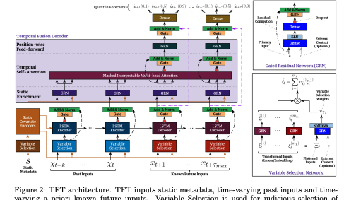
What's next
TFTModel incorporates the following main components from the original Temporal Fusion Transformer (TFT) architecture as outlined in this paper: https://arxiv.org/pdf/1912.09363.pdf
gating mechanisms: skip over unused components of the model architecture
variable selection networks: select relevant input variables at each time step.
temporal processing of past and future input with LSTMs (long short-term memory)
multi-head attention: captures long-term temporal dependencies
prediction intervals: per default, produces quantile forecasts instead of deterministic values

Slide 23


Final Concept
Genetic Algorithms applied to Temporal Convulsion Networks
Temporal Analysis Performant Evolution

Slide 24
Initial thoughts
A) Research: Temporal Convolutional Network
Dilated Convolutional Layers
Encoder/Decoder
B) Research: Genetic Algorithms
Apply to layers and hyper parameters
C) Applied: TCN – Performant Evolution – Supervised
Apply TCN network design and genetic algorithm approach to time series problem
Goal: Best Network for Temporal prediction of time series information (e.g. market data)
Output experiments across more recent designs (encoder/decoder)
Goal: Determine best genetic algorithms that can be applied (parameter tuning, black-box, binary gene encoding, adaptive) and fitness functions to apply
Output experiments across different genetic algorithms
Goal: Compare backpropagation to evolutionary approach
Output experiments across
D) Applied: TCN – Performant Evolution – Including Events
Knowledge driven events (negative effects causing abrupt changes)
Continuous learning (stream real-time data)
Output experiments across more recent designs (knowledge graphs / news events / current stock data)
Incorporate abrupt model (negative effect)

Slide 25
A) Research: TCN
Time series analysis is widely used in fields such as business, economics, finance, science, and engineering.
Our approach seeks to identify shifting economic phase and provide a framework for making asset allocation decisions according to the probability that asset may outperform or underperform.
Temporal Convolutional Networks have recently been applied to time series data where longer term memory of seasonality of the dataset are required
Research Encoder/Decoder and Knowledge Driven Event Embedding

Slide 26
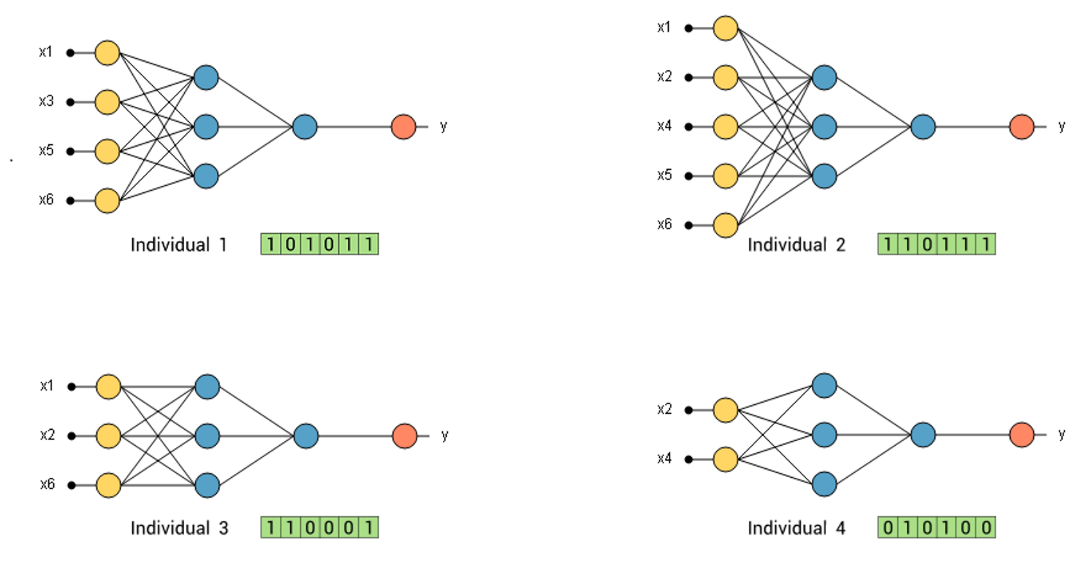
B) Research: GA
The most common task to find parameters at which a particular function reaches its maxima value
Black-box
Gene Encoding
Adaptive GA
Determine fitness function and architecture of genetic algorithms
Can an adaptive approach to selecting GA parameters be applied

Slide 27
C) Applied: E-TCN
Can TCN networks design and hyper parameters be optimized through evolutionary techniques?
Does a genetic algorithm perform better with high-dimensional and seasonal big data challenges such as market data?
Can we improve accuracy and performance of the deep neural networks?
Apply TCN network design and genetic algorithm approach to time series problem
Goal: Compare backpropagation to evolutionary approach
Output experiments across

Slide 28
D) Applied: E-TCN
Can Knowledge driven events that cause abrupt changes be incorporated into the model?
Can an adaptive continuous learning adaptive approach be applied (streaming market data and news data)?
Results of experiments in complete design
Knowledge driven events (negative effects causing abrupt changes)
Incorporate abrupt model (negative effect)
Continuous learning (stream real-time data)
Output experiments across more recent designs (knowledge graphs / news events / current stock data)

Slide 29
Appendix
Charts

Slide 30
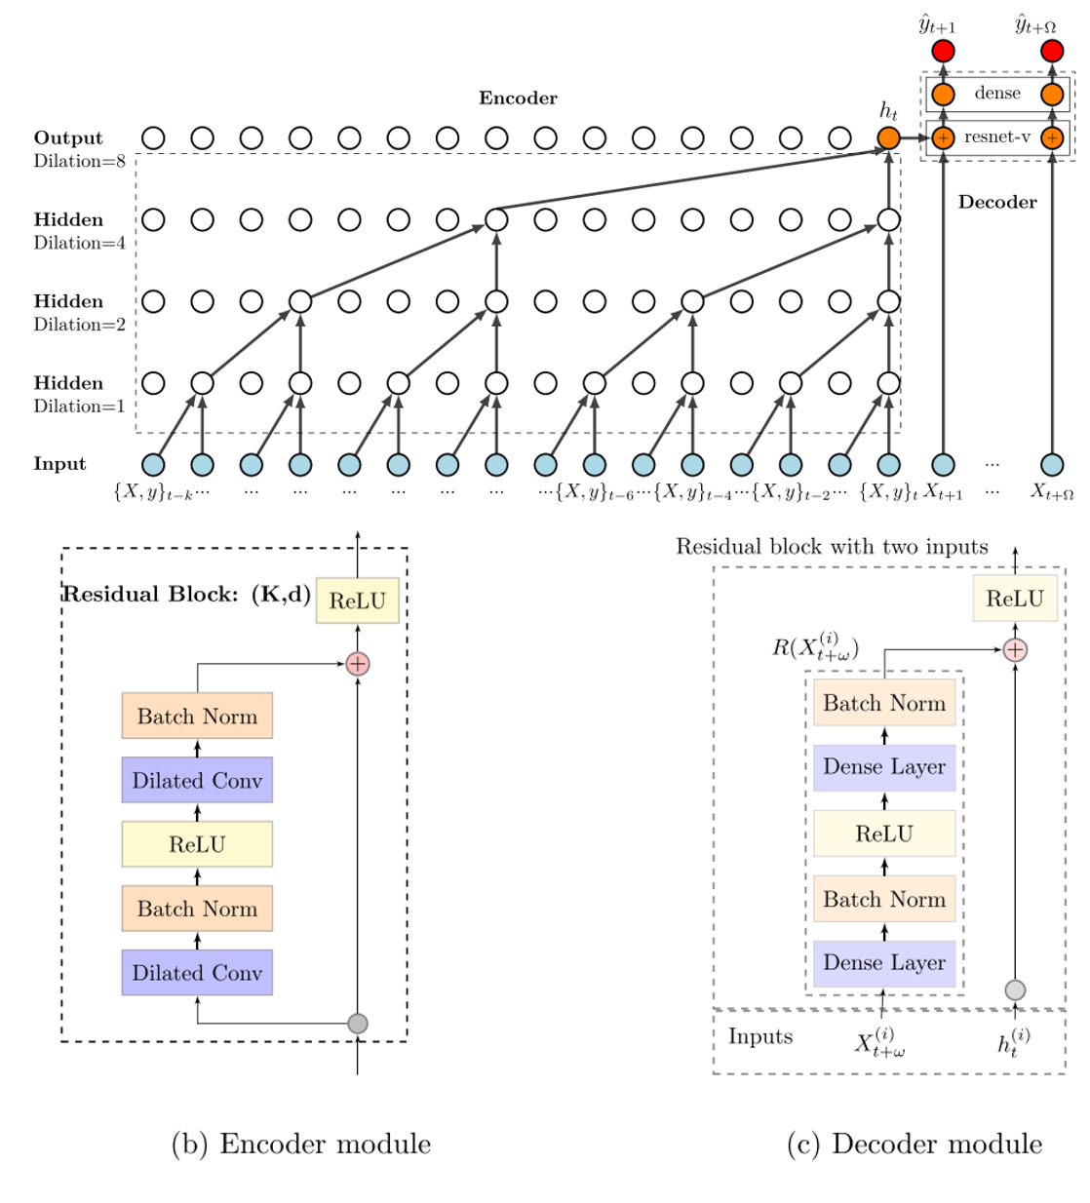
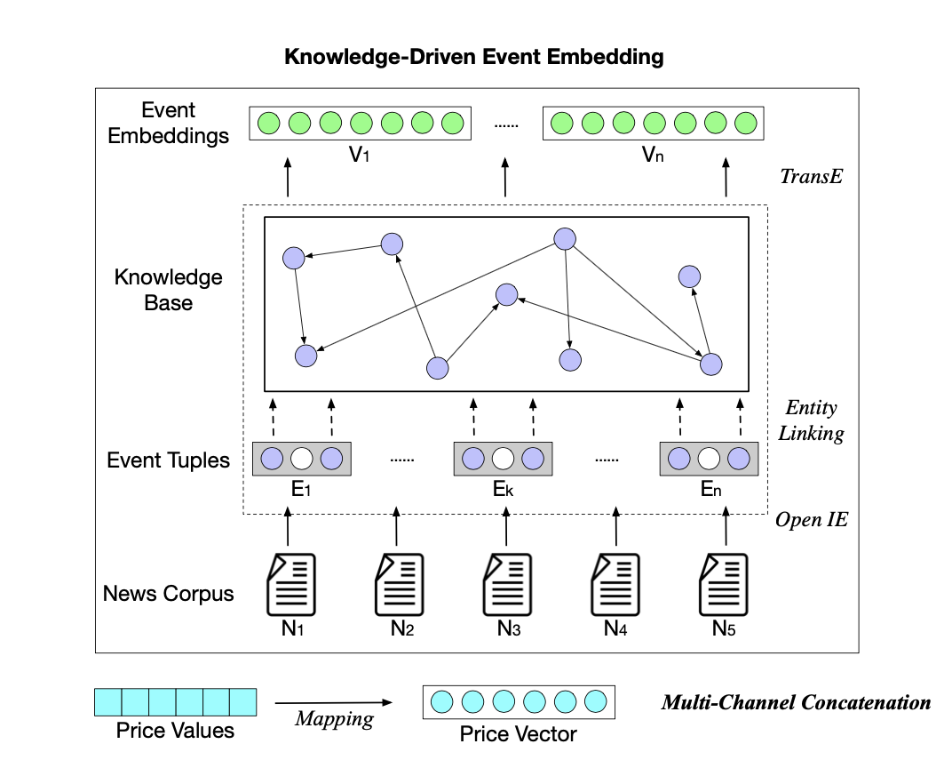
Newer concepts

